Slide 1
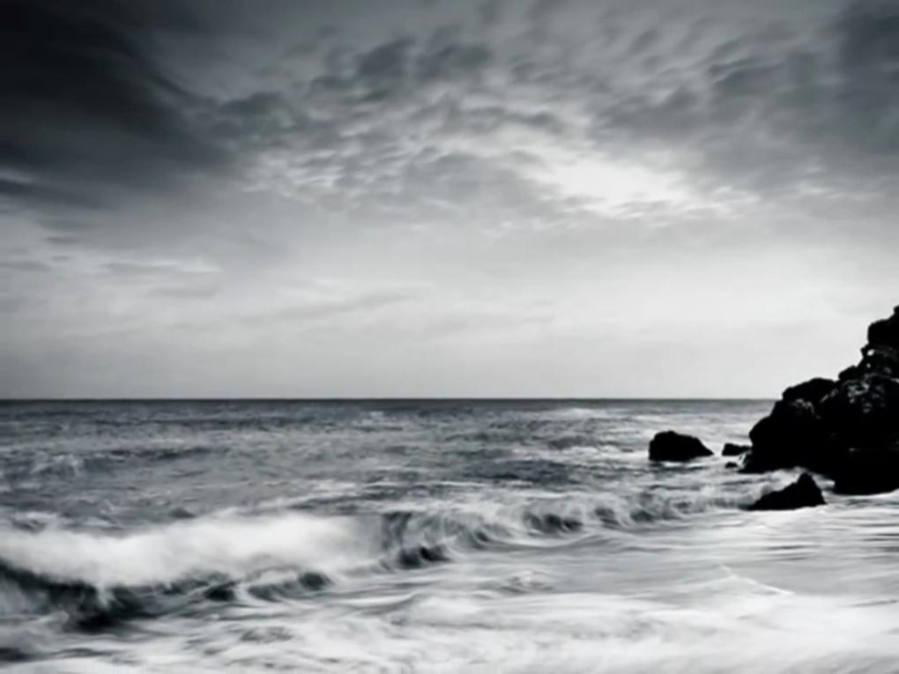
Dr. S.M. Baggio

Slide 2
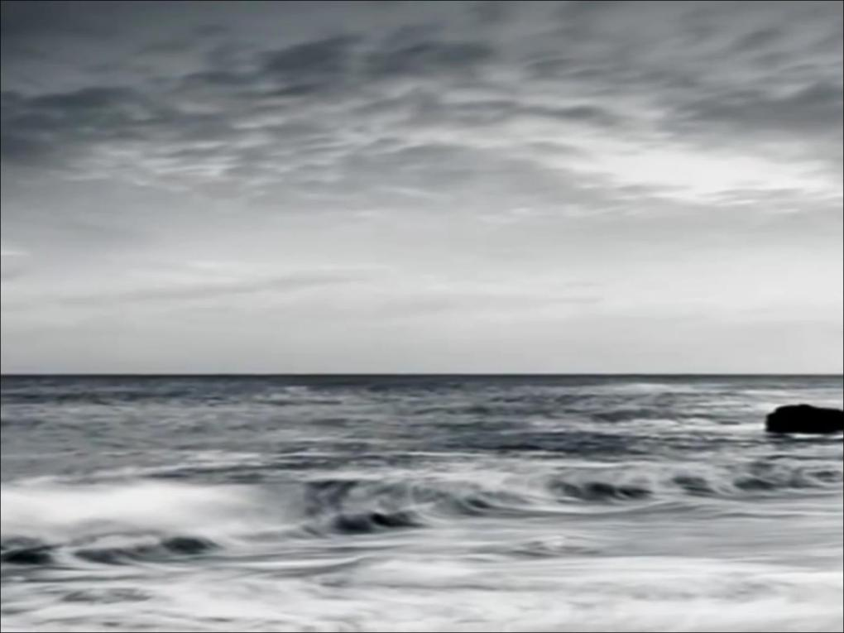
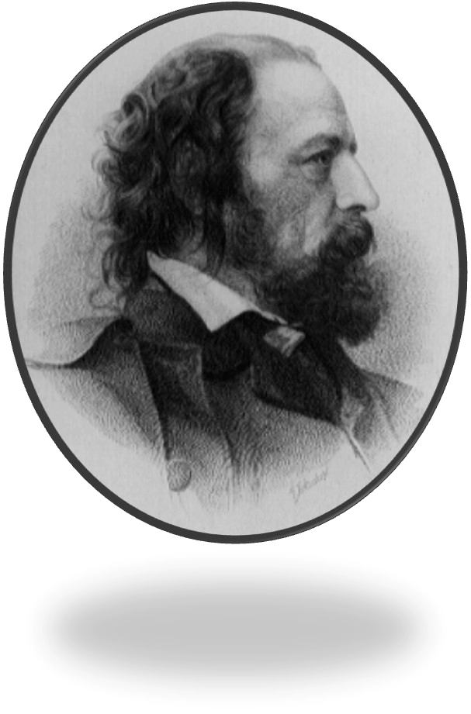

Slide 3
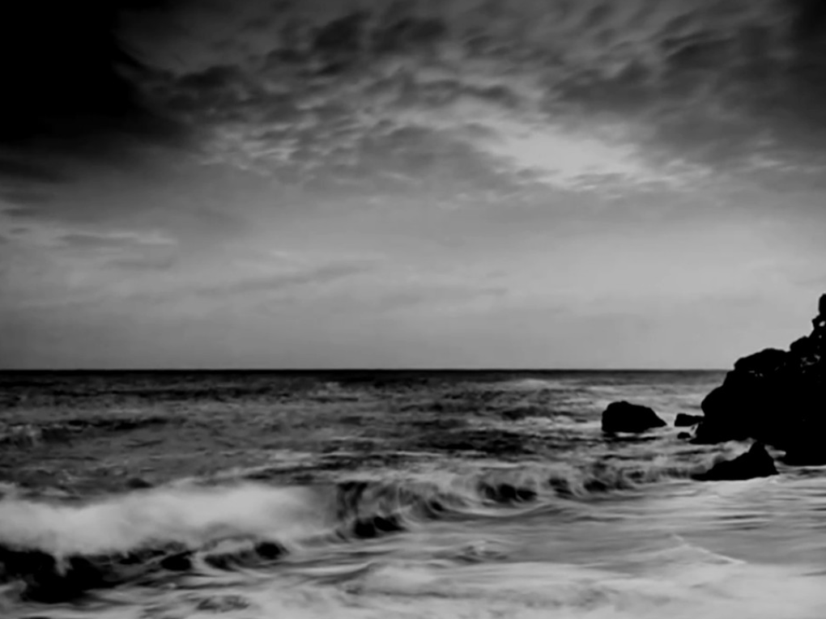

Slide 4
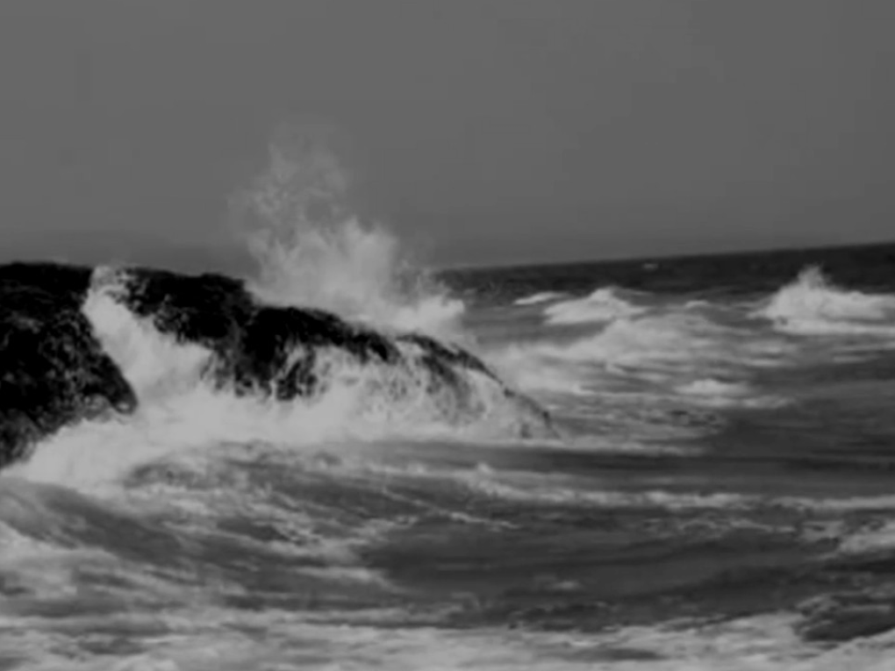

Slide 5
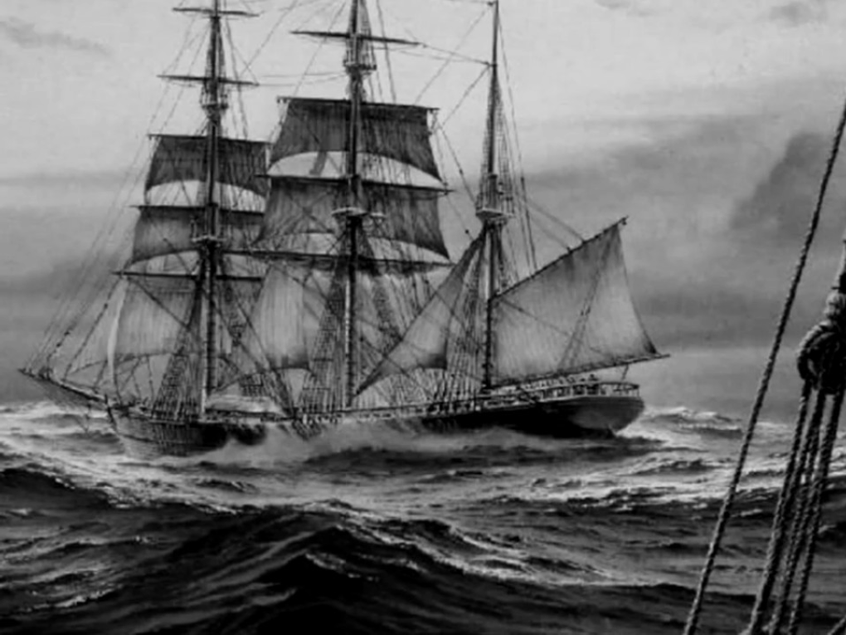

Slide 6
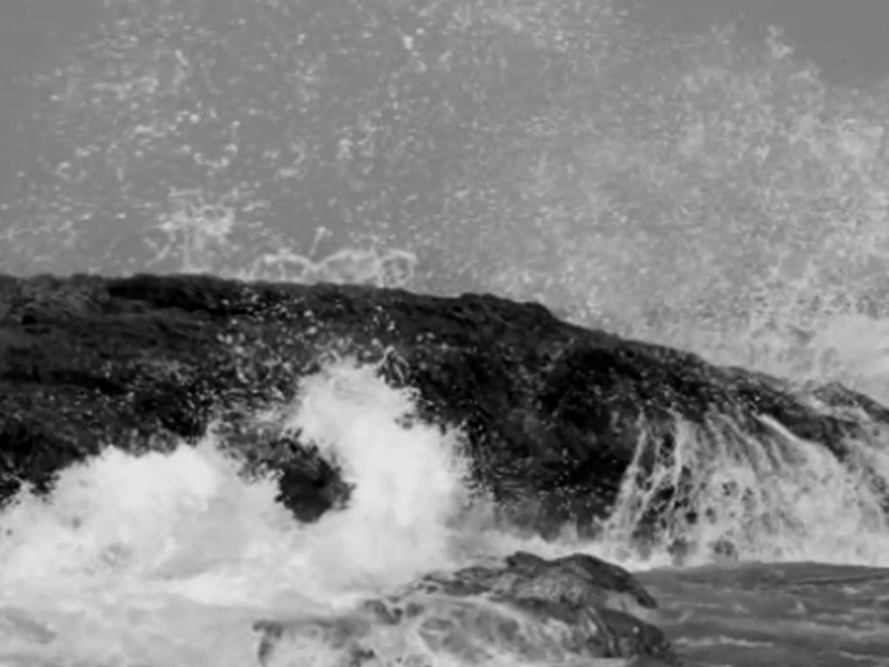

Slide 7
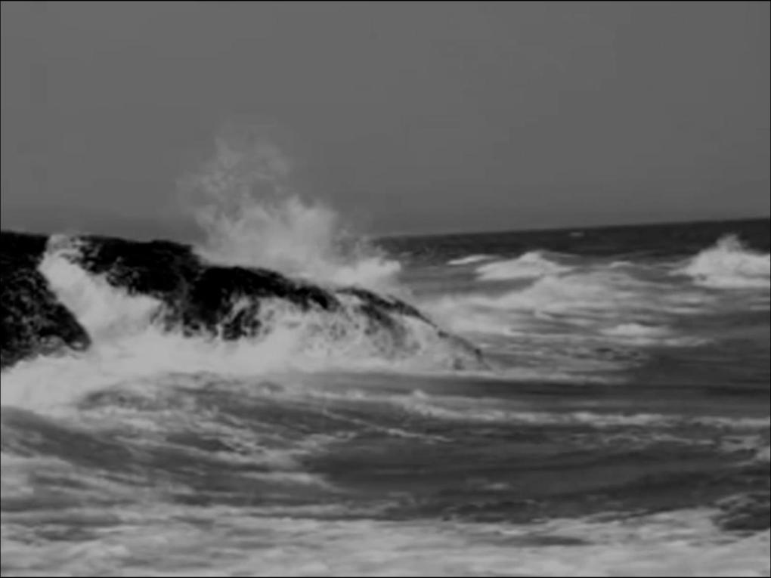

Slide 8
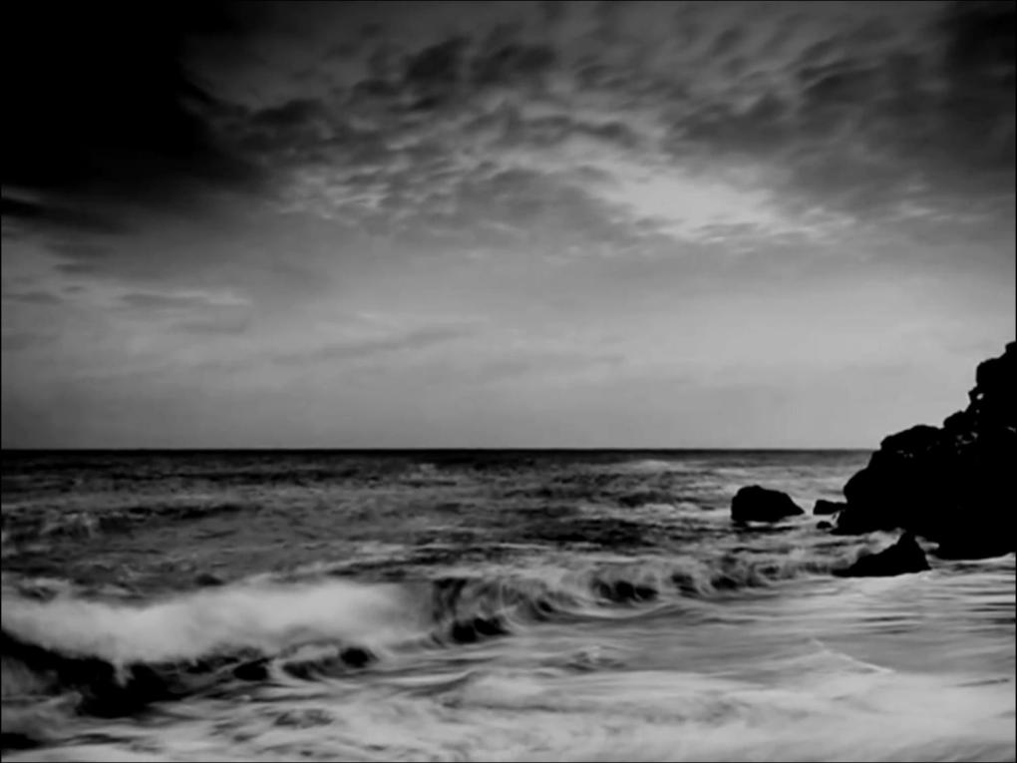
In the first stanza, the poet says that the torment of his heart is tremendous. There is a struggle like the struggle of the sea waves on the stormy shores. The question before him is how he can express adequately the thoughts which are rushing in his mind.

Slide 9
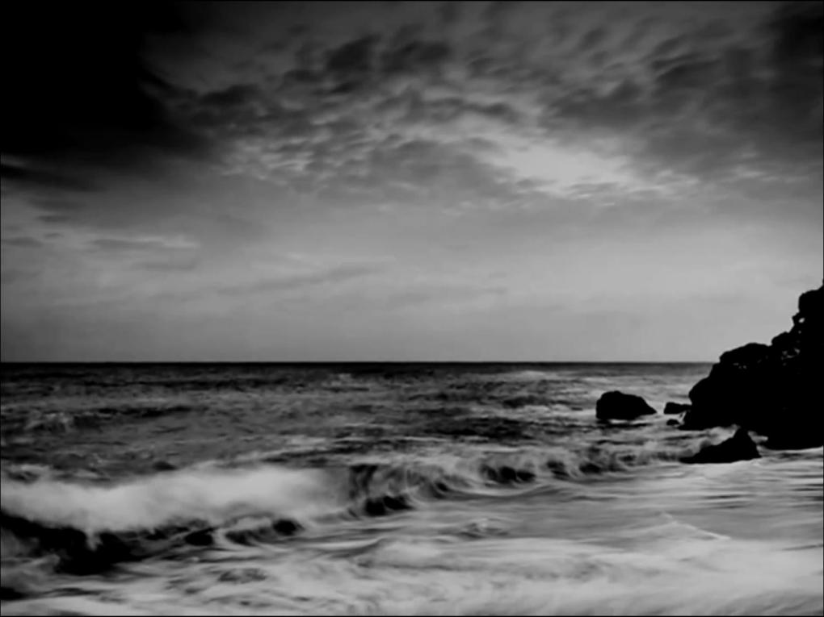
In the second stanza, the poet says that life is full of joy for the fisherman’s son and daughter who are laughing and shouting merrily. The poet, on the other hand, is entirely in a different mood. He is restless and grief-stricken at the death of his friend. The poet admires the innocent joy of these youngsters but he is sorry because he cannot share it. The lad of the sailor is also happy and sings in his boat face to face with the magnificence of the sea. But such joy is not for the poet.

Slide 10
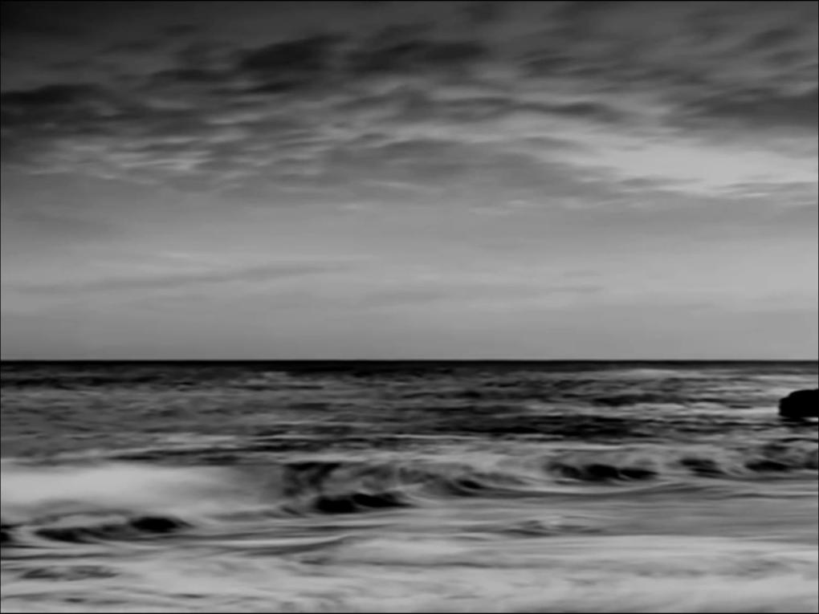
In the third stanza, the poet says that the majestic ships ply on their destination under the hill. The poet however has no definite plan about his life and he misses his friend Hallam whose voice and touch were so soft and tender. The grief of the poet is terribly intense.

Slide 11
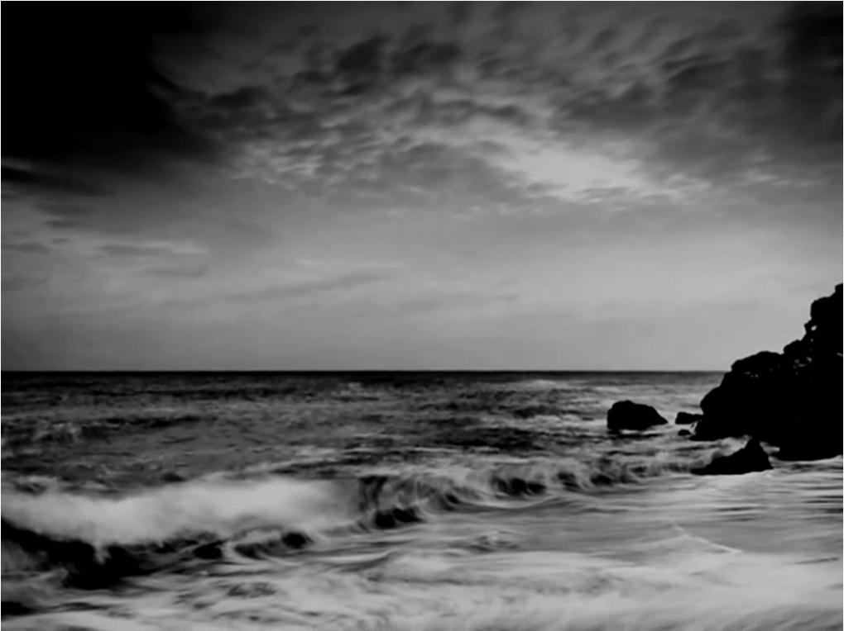
In the fourth stanza, the poet asks the waves to go on striking against the sea-shore, but the poet cannot recall the past experience which he enjoyed in the company of his friend. God had been very kind in blessing him with the tender friendship of Hallam, but the past cannot be recalled.

Slide 12
THEME
Death: The poem is indirectly about death. However Tennyson also refers to it directly. The metaphor in stanza three alludes to death: “And the stately ships go on/To their haven under the hill.” The ship is a metaphor of life, now gone to its rest (or 'haven'). Then the poet speaks about the hand that vanished and the voice that is still. The opening stanzas make no such reference to the poet's dead friend, but merely prepare the reader for it. Another direct reference to death occurs in the last stanza, speaking of the figurative death of the day: “But the tender grace of a day that is dead/Will never come back to me.”

Slide 13
ELEGY
The elegy is one of the most popular poetic forms during the Victorian period.
It is a form of poetry that laments the dead or the past.
This poem is elegiac. It is one of many poems that Tennyson wrote in response to the death of a close fiend.

Slide 14
FORM
Stanza Form: The poem consists of four stanzas. Each stanza consists of four lines, thus called also a quatrain. In the first and last stanzas, the poet addresses the sea, expressing his sadness and sense of loss. The middle two stanzas present images of joy and happiness. The contrast helps highlight the poet’s sense of grief and loss.
Rhyme Scheme: In each stanza, the rhyme scheme is abcb.
Refrain: The refrain “Break, Break, Break” that consists of one word repeated three times parallels the waves that repeatedly beat the cliffs. The sea will continue to “break” upon the rocks relentlessly, as we are reminded by the repetition of the phrase.

Slide 15
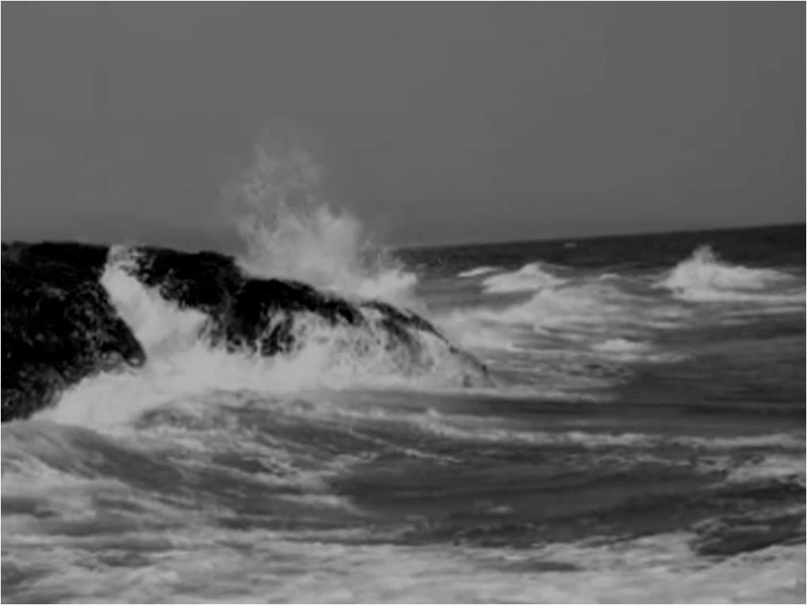
FIGURES OF SPEECH
Metaphor: The ship is a metaphor of life.
Personification: “a day that is dead”
Synecdoche: It is a figure of speech in which the part of something refers to the whole as in “But O for the touch of a vanish'd hand,/And the sound of a voice that is still!”
Paradox: It is a statement that is apparently contradictory as in “touch of a vanish'd hand, and “the sound of a voice that is still.”

Slide 16
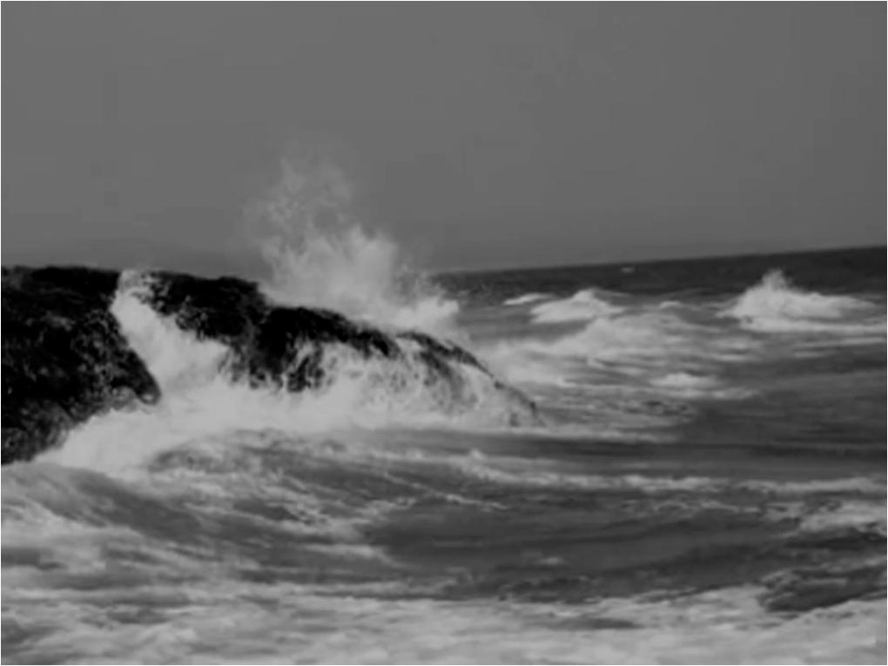
Onomatopoeia: It is the figure of speech in which the sound of the words echoes their meaning. The word Break, sounds like something breaking. It is intended to echo the sound of the waves breaking against the rocks.

Slide 17
The Poem As an Example of Victorian Poetry
The Elegiac Tone
This poem is an elegy. The elegy is one of the most popular poetic forms in the period, a form of poetry that laments the dead or the past.
The Sense of Spiritual Doubt
The Victorian period was a period of religious doubt. The conflict between science and religion resulted in people’s sense of doubt about the validity of their beliefs. Darwin’s theory of evolution, in particular, led to a crisis of faith and spiritual doubt among so many people. The poem reveals a secular rather than a religious attitude towards death. The poet’s attitude towards death is characterized by a sense of total loss and despair, rather than acceptance and comfort based on belief in life after death and hope of immortality.

